Slide 1
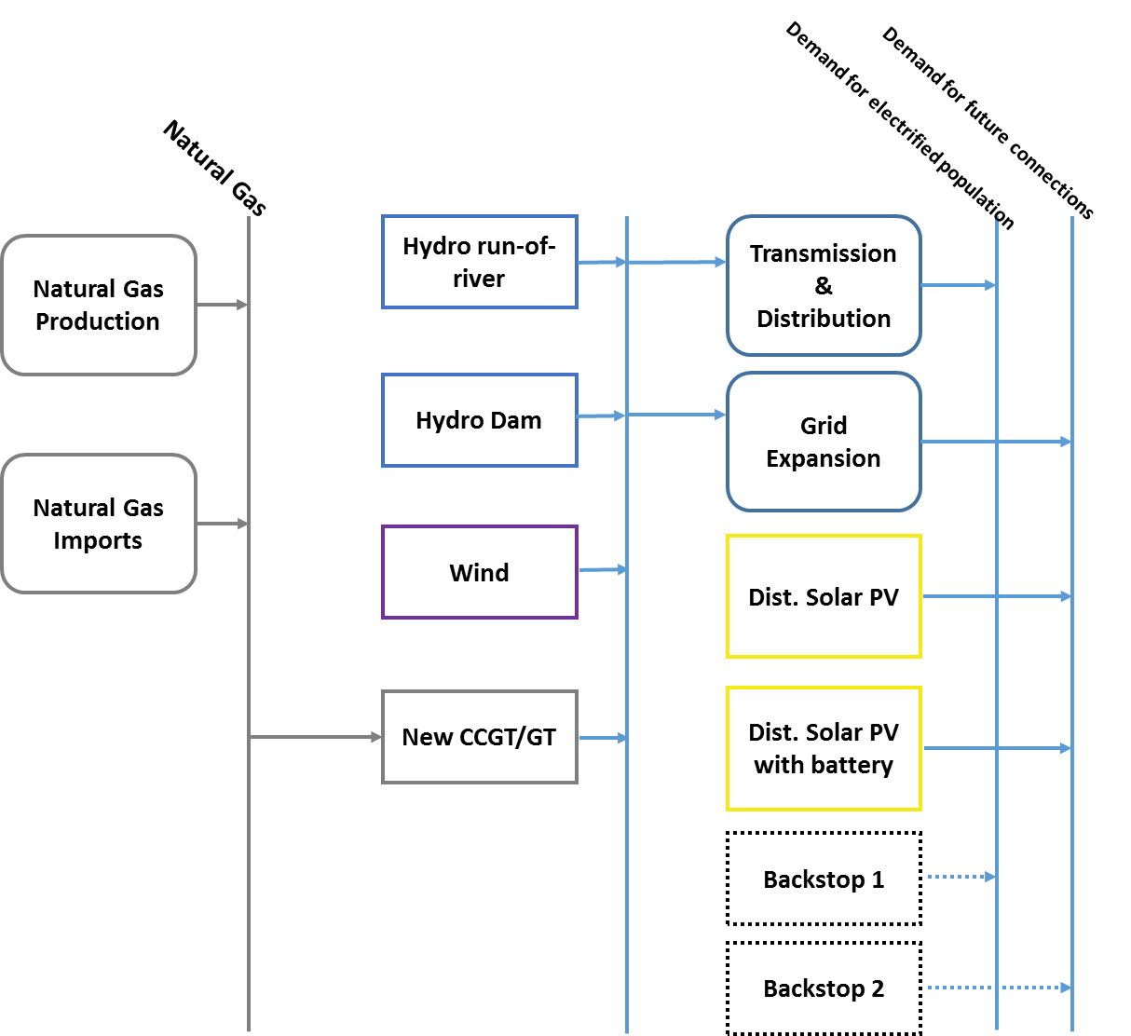
Emission Representation in OSeMOSYS
Technology dependent emissions should be accounted for within the respective technology
Fuel dependent emissions can be accounted for at the primary energy supply level

Slide 2
Representing emissions in OSeMOSYS
In OSeMOSYS, emissions are characterized by the following parameters:
EmissionActivityRatio [Mt/PJ or Mt/GWh]: defines the rate of emission by each technology.
Optional:
EmissionsPenalty [M$/Mt]: defines the cost per unit of emission.
AnnualExogenousEmission [Mton]: defines annual level of emissions not captured by the considered system, but that should be accounted for.
AnnualEmissionLimit [Mton]: sets an annual upper limit on the total emissions of a particular pollutant.
ModelPeriodExogenousEmission [Mton]: defines model period level of emissions not captured by the considered system, but that should be accounted for.
ModelPeriodEmissionLimit [Mton]: sets an upper limit on the model period on the total emissions of a particular pollutant.

